Slide 1
Supremocracy
in crisis
Oscar Vilhena Vieira
Tinker Conference: The Rule of Law in Latin America
December 7-8 2017
Stanford University

Slide 2
Supremocracy
is the unprecedented power conferred to the Brazilian Supreme Court to provide the last word on an extensive set of political, economic and moral issues entrenched by 1988 Constitution

Slide 3
Institutional path towards supremocracy
Adoption of a maxi-constitution
Overlapping functions at the STF
Access to political actors
Expansion of responsive legal doctrines

Slide 4
Maximization Compromise
process
Political distrust
Reactive moment
From the scratch
Inclusive rules
Massive participation
Fragmented political forces
Corporatism
Patrimonialism
result
Ambitious
Ubiquitous
Legally unpolished
Contradictory
Resilient
Flexible ordinary clauses
Unamendable clauses

Slide 5
Overlapping functions at the STF
ADI, ADC, ADF
Constitutional court
Binding effect
Power to control amendments to the constitution
Extra-ordinary appeals
Court of last appeals
Habeas corpus
General repercussion/binding effect
First instance court
Controlling abuse of power
Controlling political criminality

Slide 6
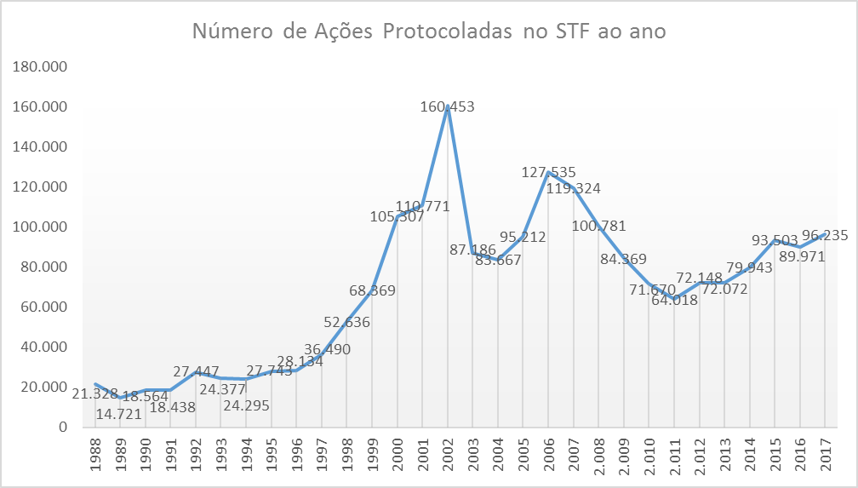
Explosion of constitutional litigation

Slide 7
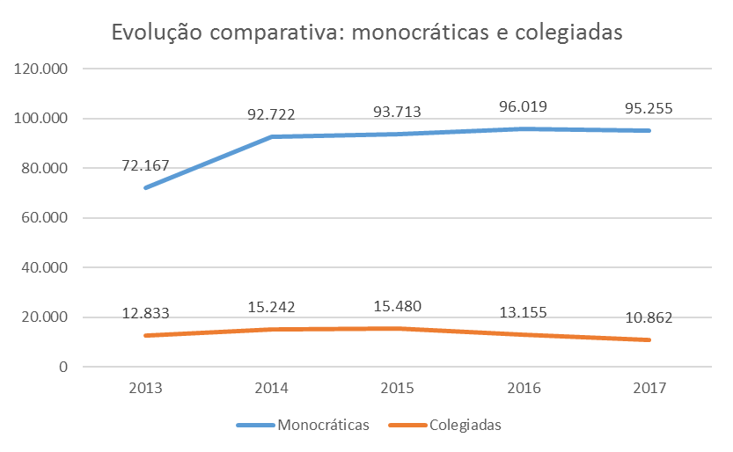
Fragmentation of the STF jurisdiction

Slide 8
Direct access of political actors to the STF
President of the Republic;
Executive Committee of the Federal Senate;
Executive Committee of the Chamber of Deputies;
Executive Committee of a Legislative Assembly …;
Governor of a State or the Federal District;
Procurator-General of the Republic;
Federal Council of the Brazilian Bar Association;
political party represented in the National Congress;
syndical confederation or a national class entity

Slide 9
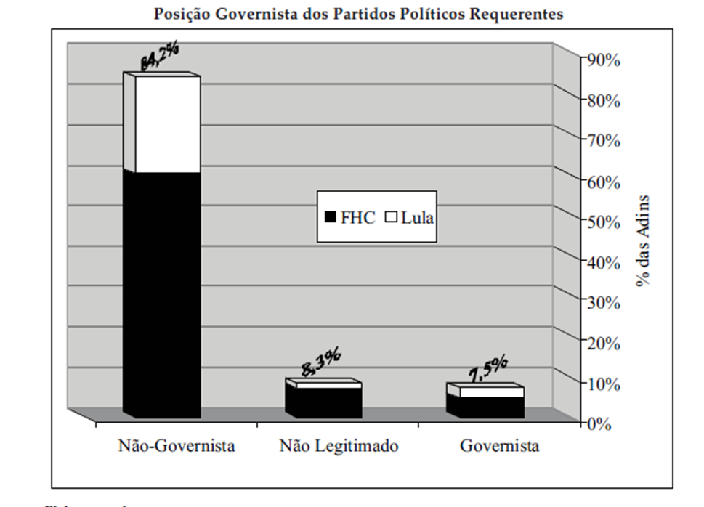

Slide 10
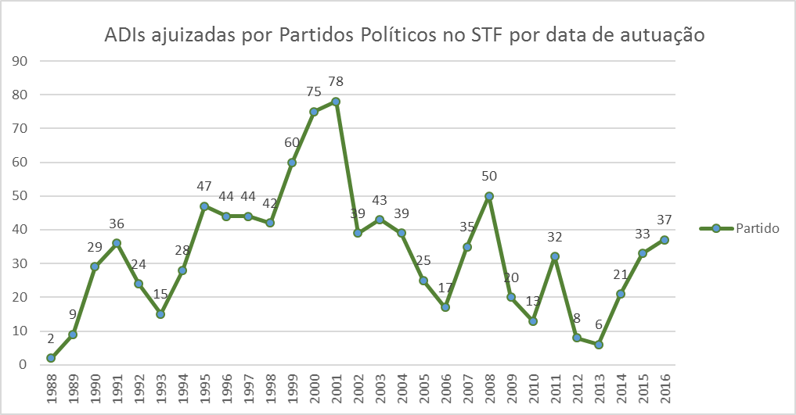

Slide 11
responsive and flexible legal doctrines
Efficacy
Morality
Efficiency
Proportionality

Slide 12
LEGAL CONSISTANCE
Deference
Responsive
moderator
Omission
Usurpation
INSTITUTIONAL POSTURE

Slide 13
Supremocracy in crises
Material fatigue
Fragmentation
Inconsistency
Declining judicial trust

